Slide 1





PHÂN LOẠI HÌNH ẢNH SẢN PHẨM THỜI TRANG THƯƠNG HIỆU ADIDAS, UNIQLO VÀ YAME
IMAGE CLASSIFICATION OF FASHIONPRODUCTS
FROM ADIDAS, UNIQLO, AND YAME
04.2025

Slide 2
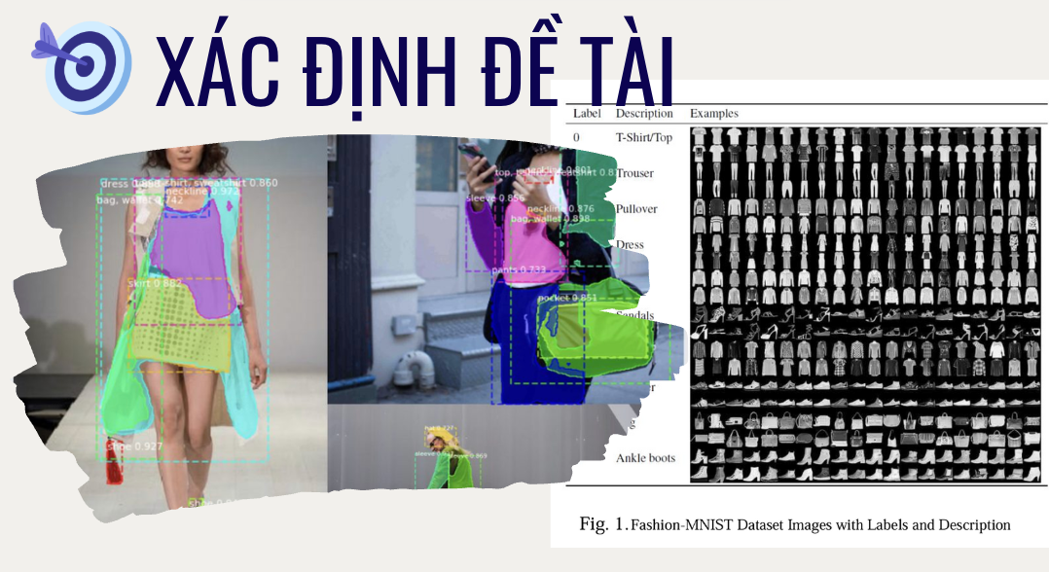

Slide 3

CHUẨN BỊ DỮ LIỆU

Slide 4
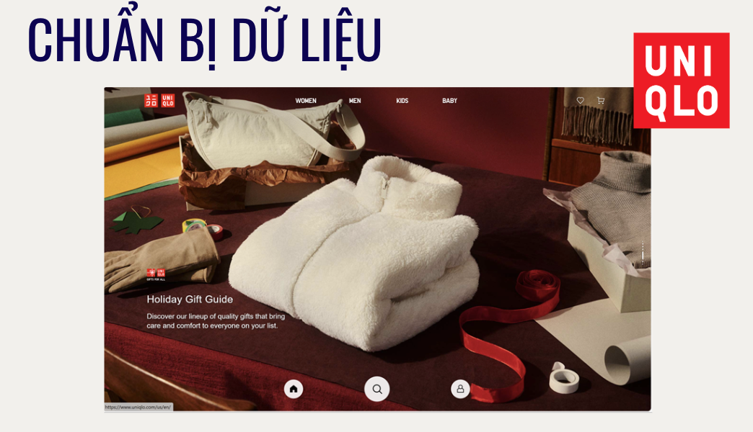

Slide 5


Slide 6
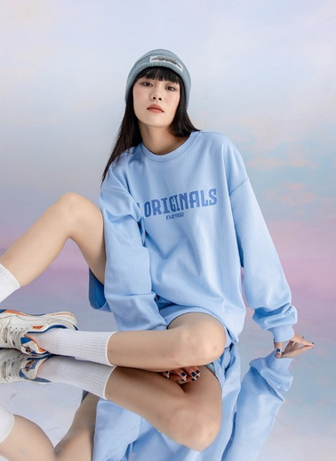
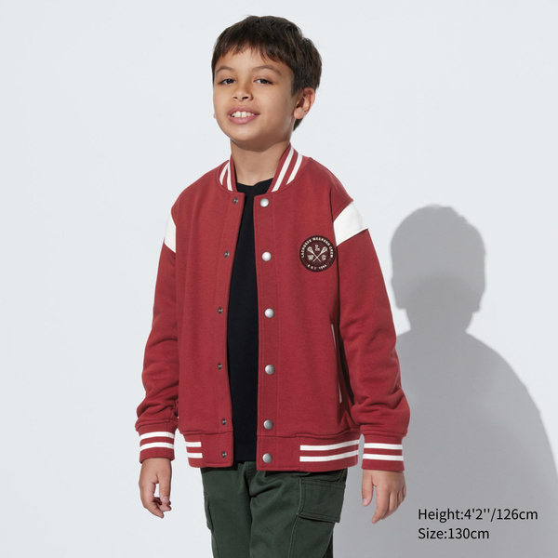
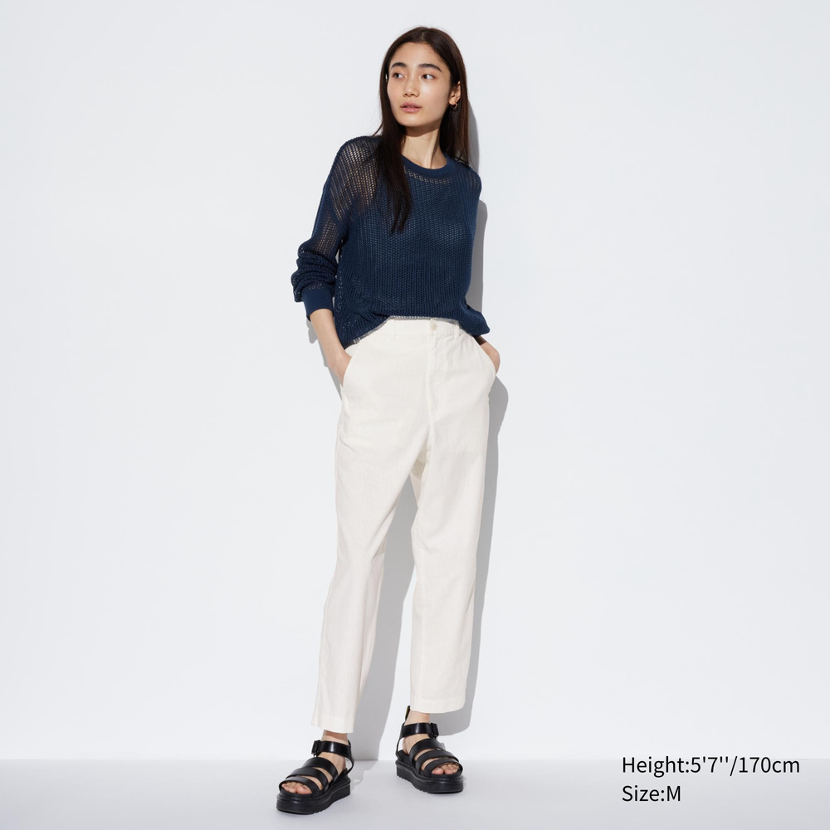
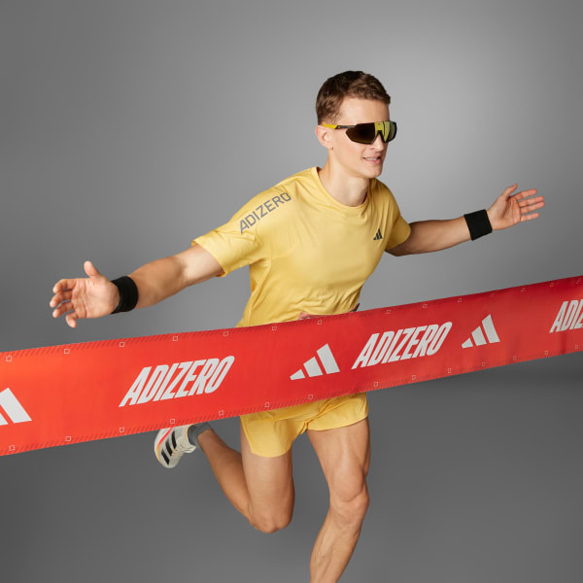
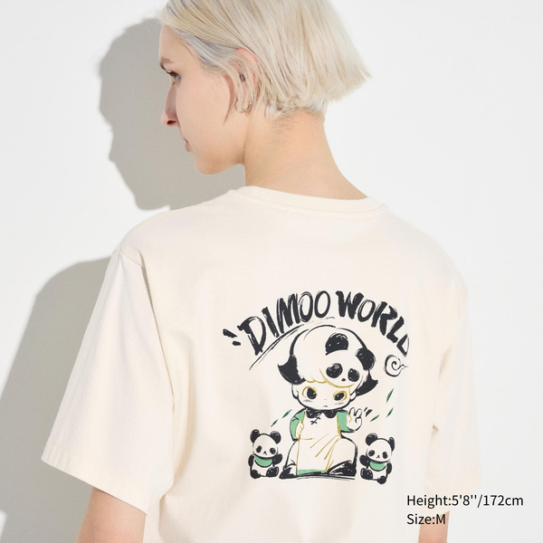

IMAGES DATA LOOK LIKE

Slide 7
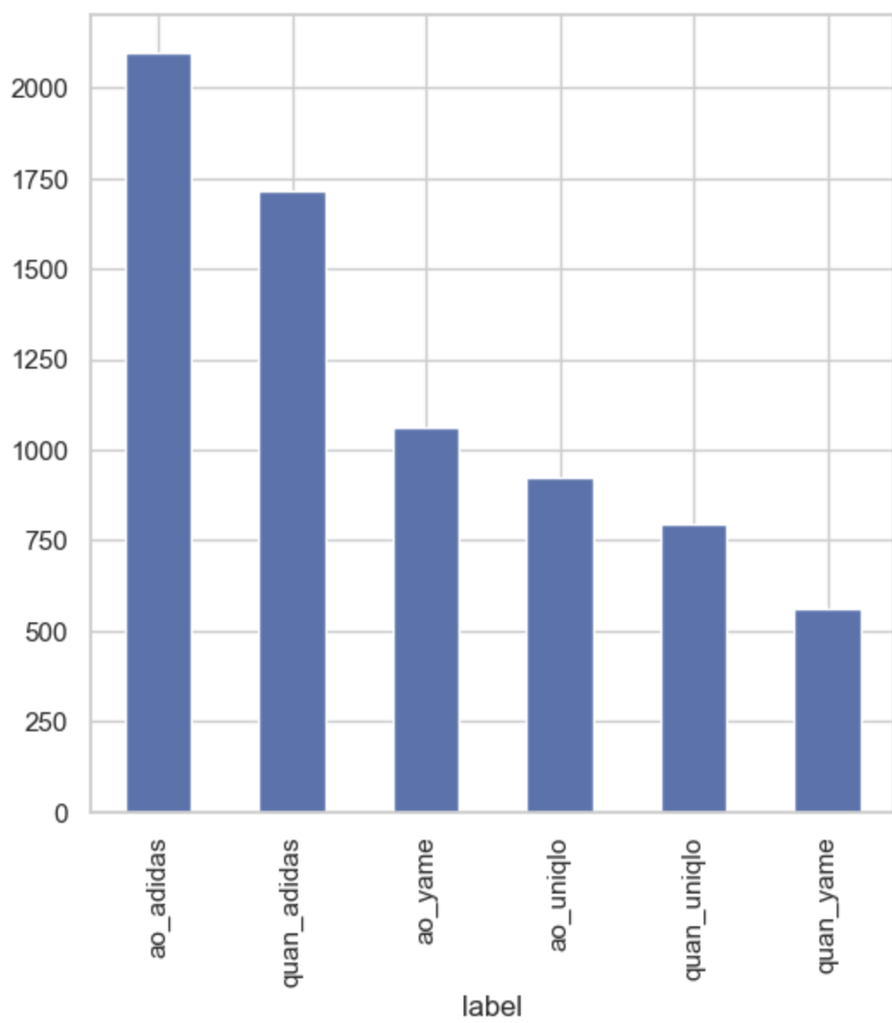

DATA LABEL DISTRIBUTION
LABEL

Slide 8

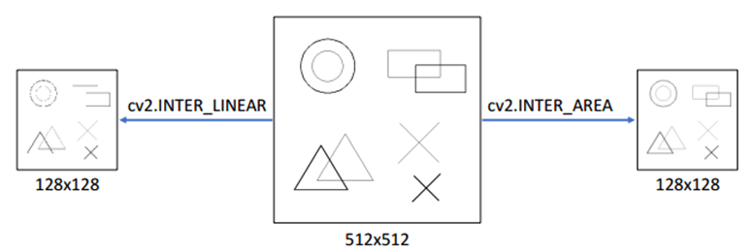
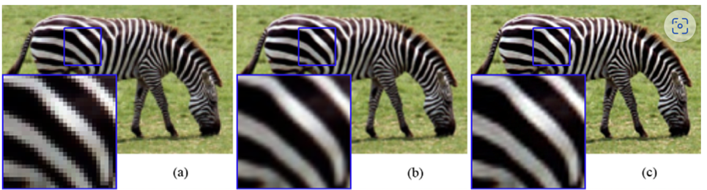
TIỀN XỬ LÝ ẢNH
CV2.INTER_LINEAR
CV2.INTER_LANCZOS4
CV2.INTER_CUBIC

Slide 9
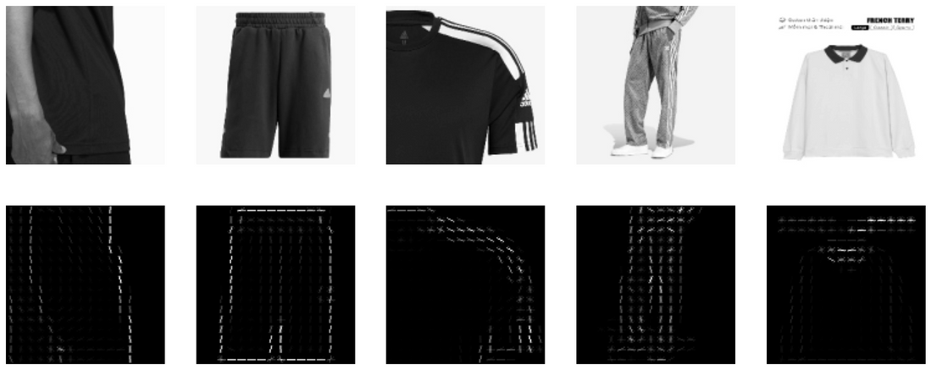
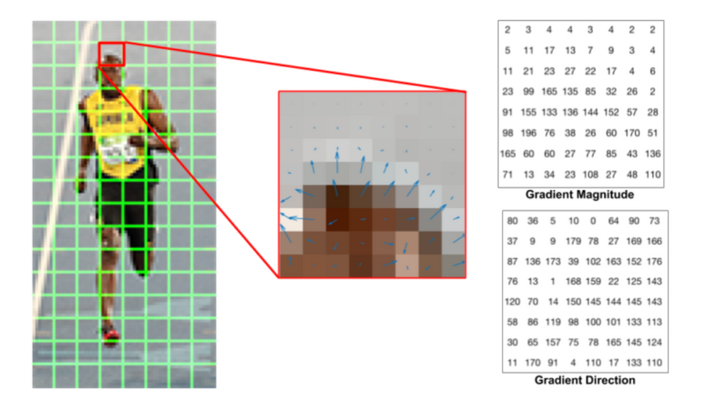
FEATURE EXTRACTION (HOG, SIFT, ...)

Slide 10
FEATURE EXTRACTION (HOG, SIFT, ...)

Slide 11
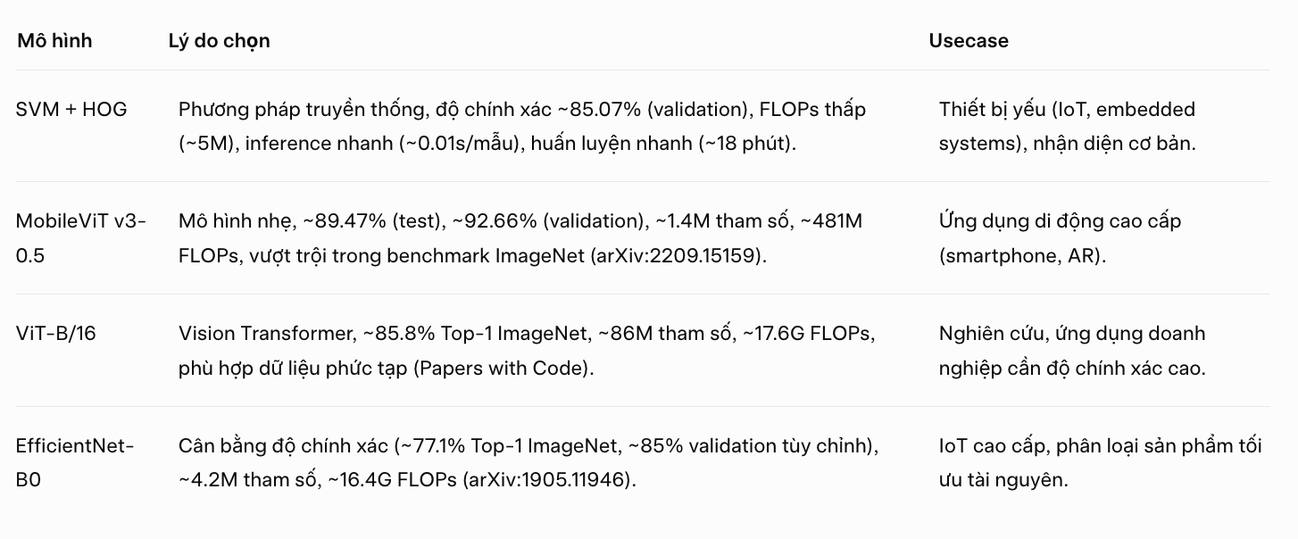
CÁC MODEL ĐƯỢC CHỌN

Slide 12
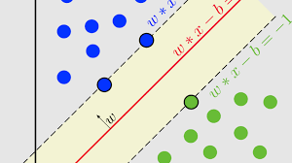
SVM

Slide 13
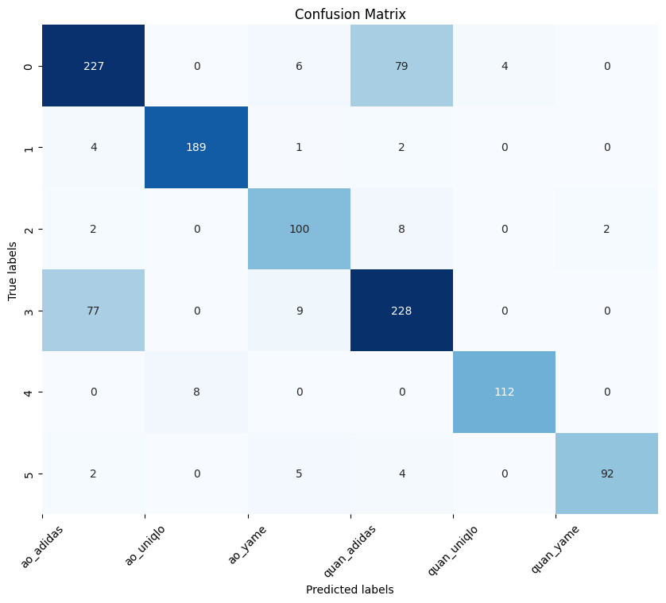
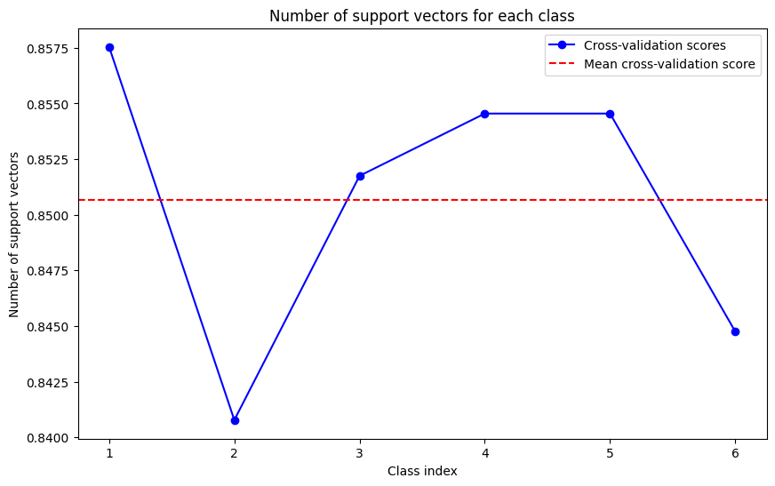
SVM

Slide 14
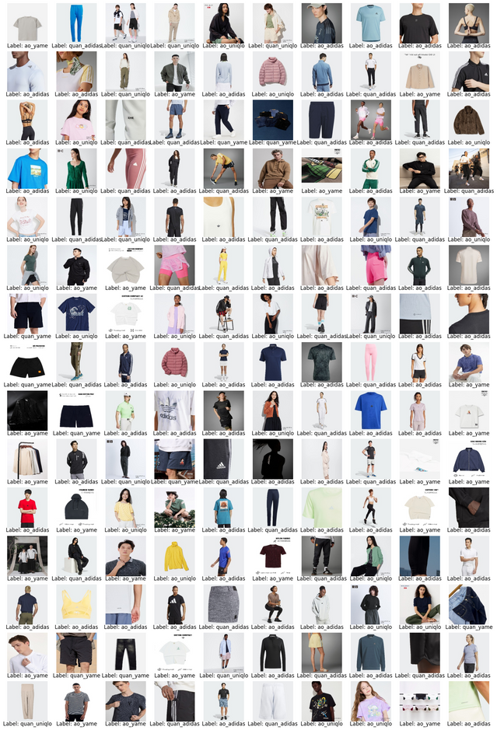
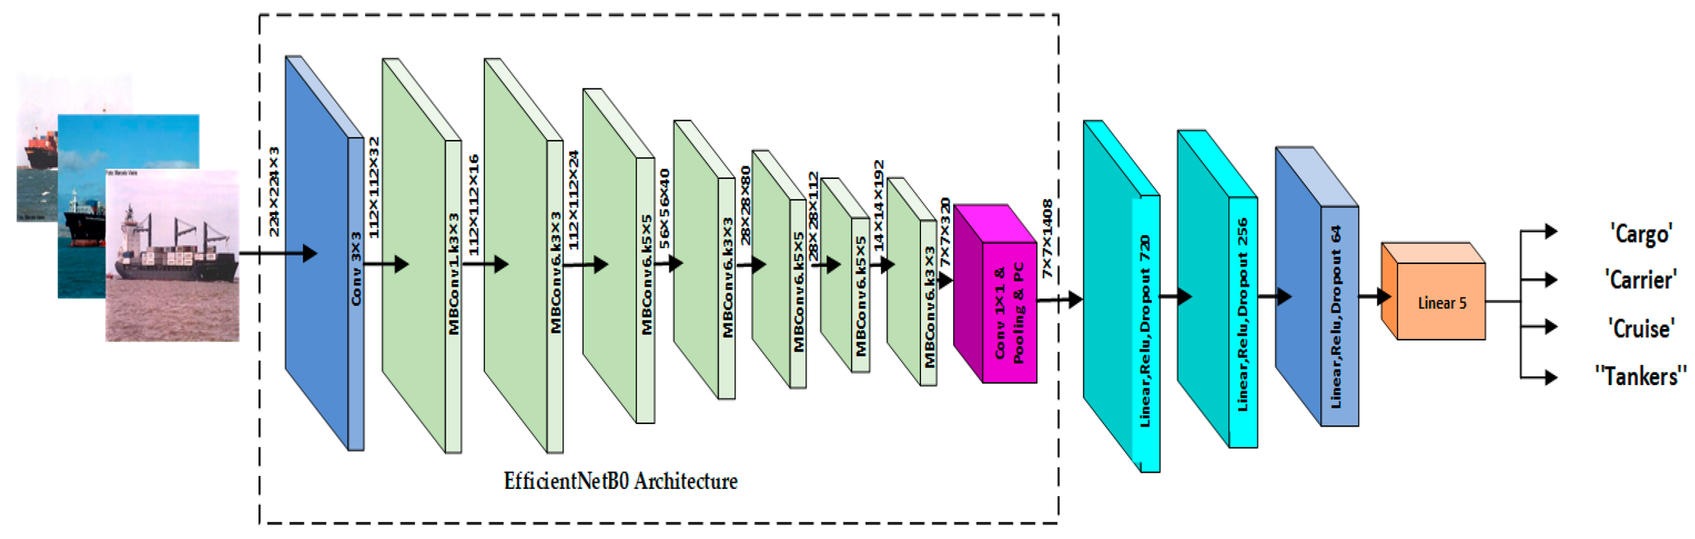
EFFICIENTNET
EFFICIENTNET: RETHINKING MODEL SCALING FOR CONVOLUTIONAL NEURAL NETWORKS

Slide 15
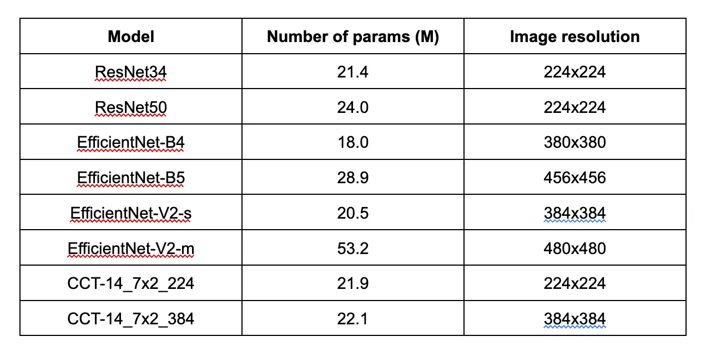
EFFICIENTNET
EFFICIENTNET: RETHINKING MODEL SCALING FOR CONVOLUTIONAL NEURAL NETWORKS

Slide 16
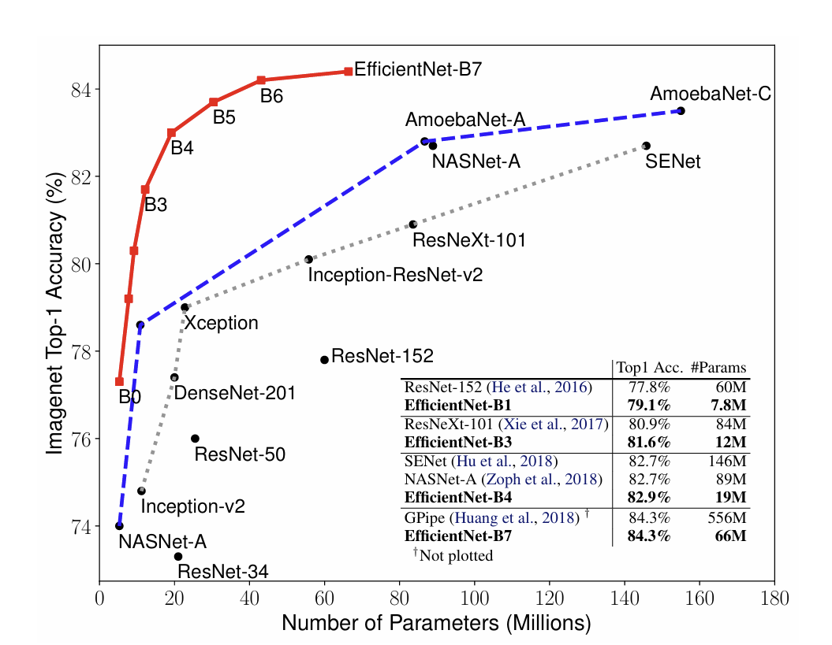
EFFICIENTNET
EFFICIENTNET: RETHINKING MODEL SCALING FOR CONVOLUTIONAL NEURAL NETWORKS

Slide 17
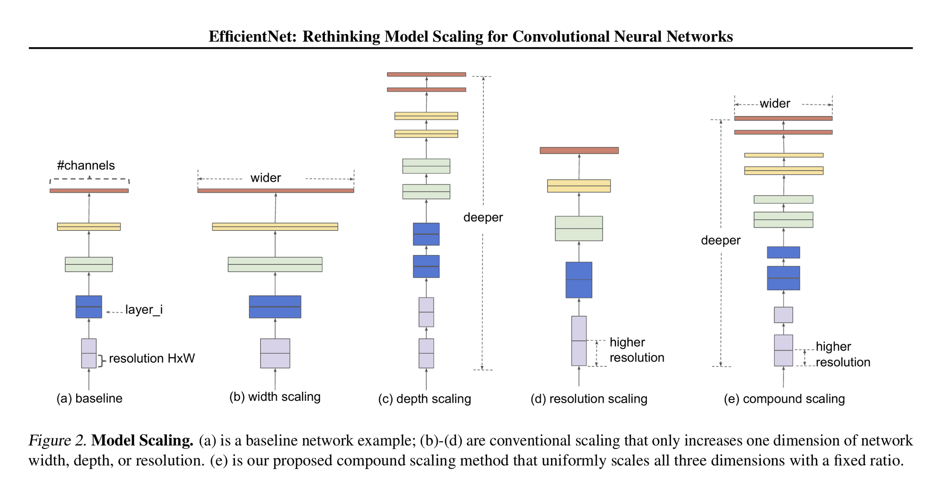
EFFICIENTNET: RETHINKING MODEL SCALING FOR CONVOLUTIONAL NEURAL NETWORKS

Slide 18
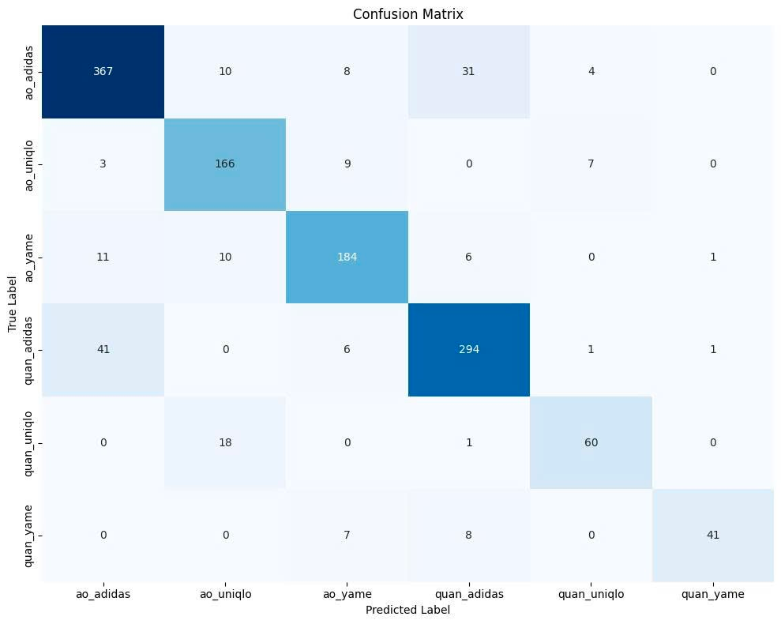
EFFICIENTNET

Slide 19
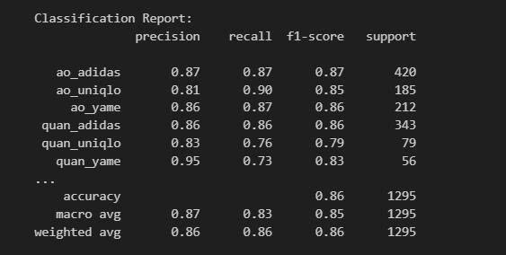
EFFICIENTNET

Slide 20
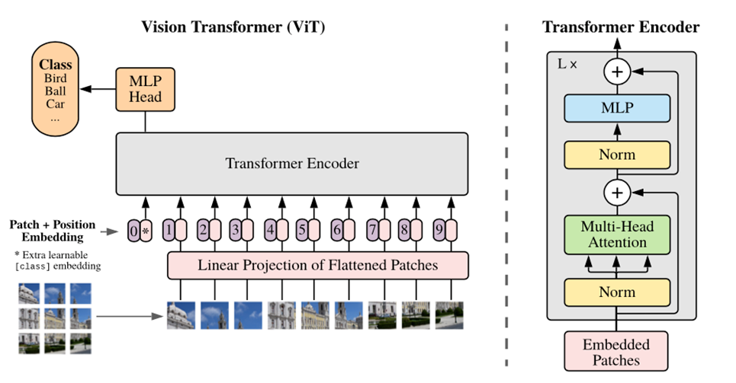
VISION TRANSFORMER (VIT)

Slide 21
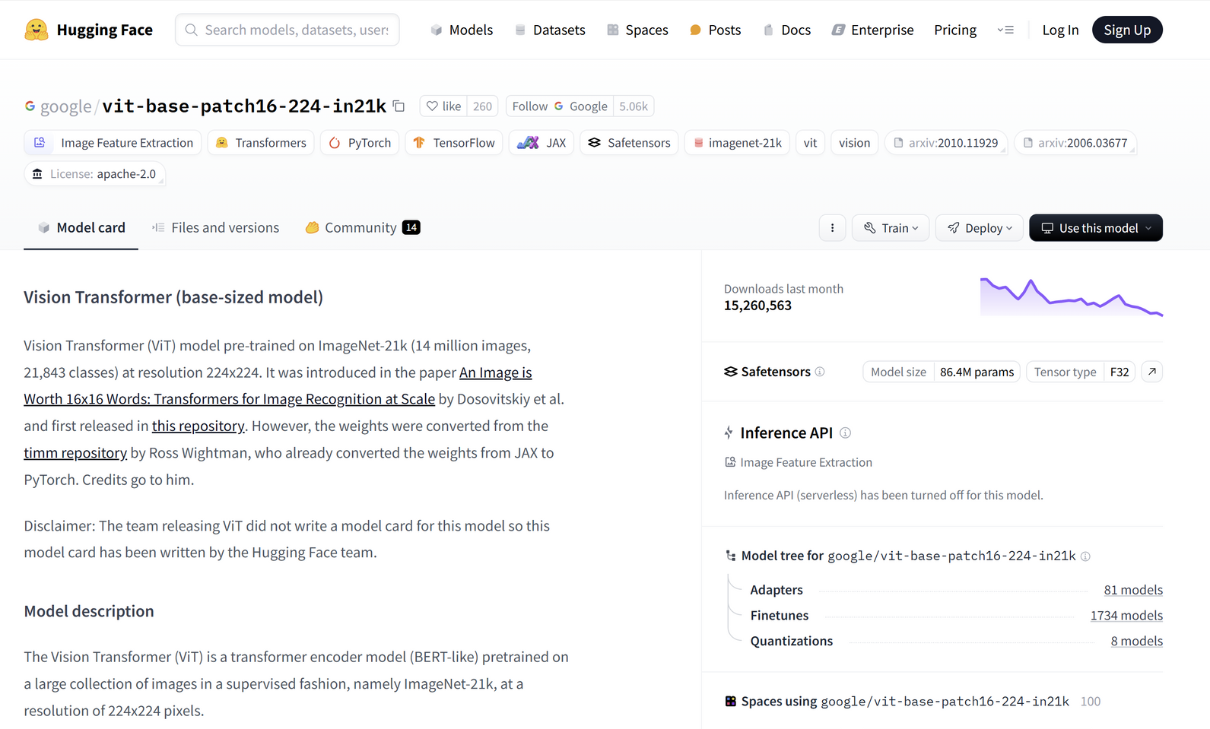
VISION TRANSFORMER (VIT)

Slide 22
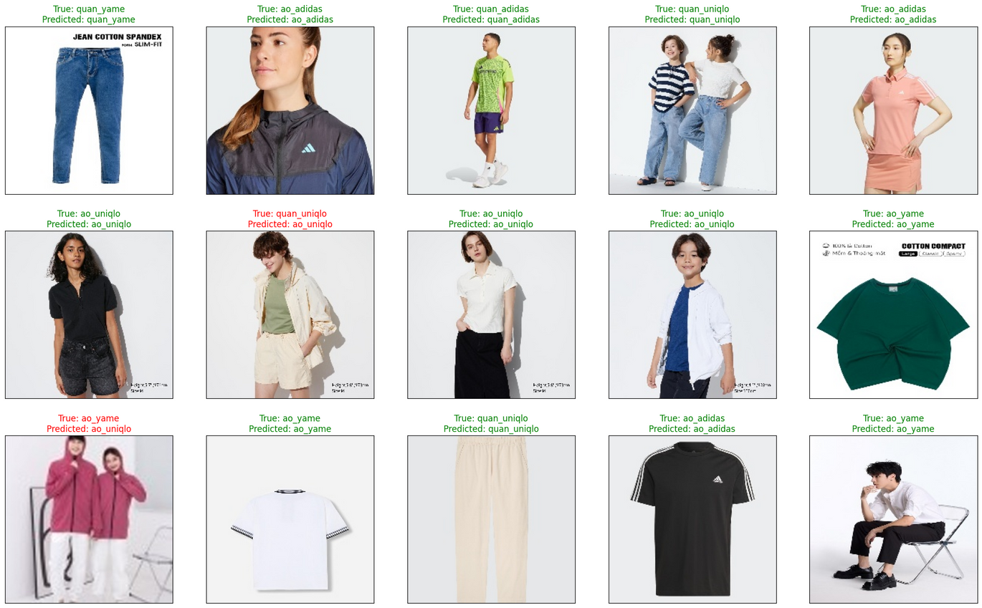
VISION TRANSFORMER (VIT)

Slide 23
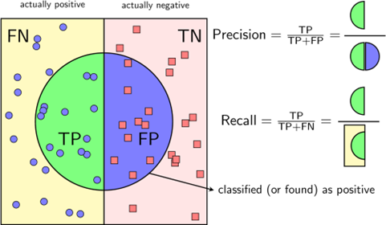

Slide 24
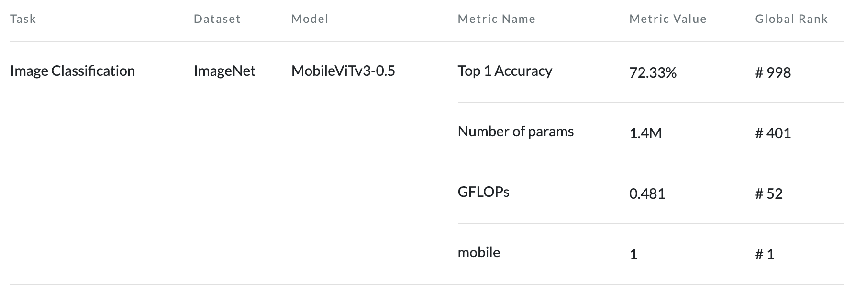
MobileViTv3

Slide 25
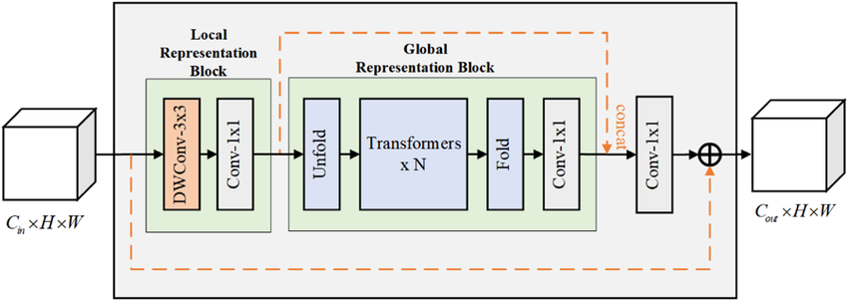
MobileViTv3

Slide 26
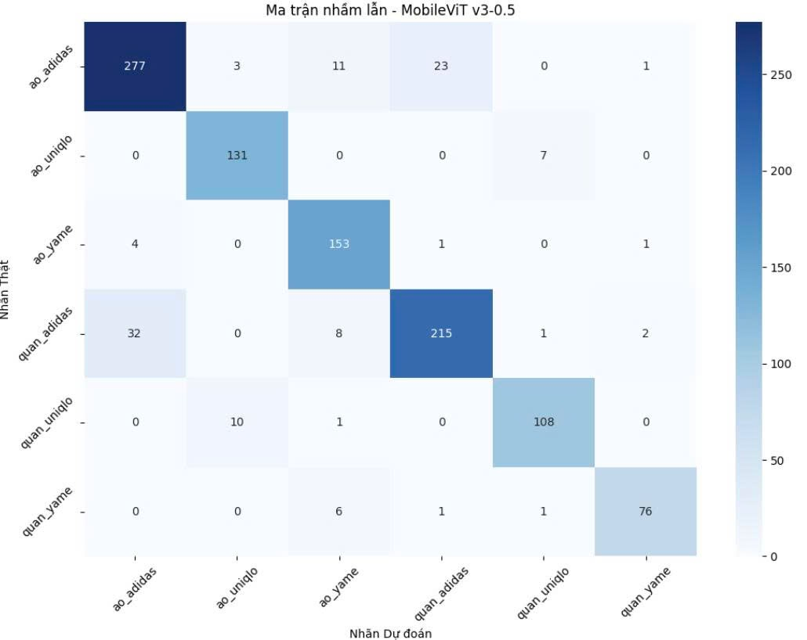
MobileViTv3

Slide 27
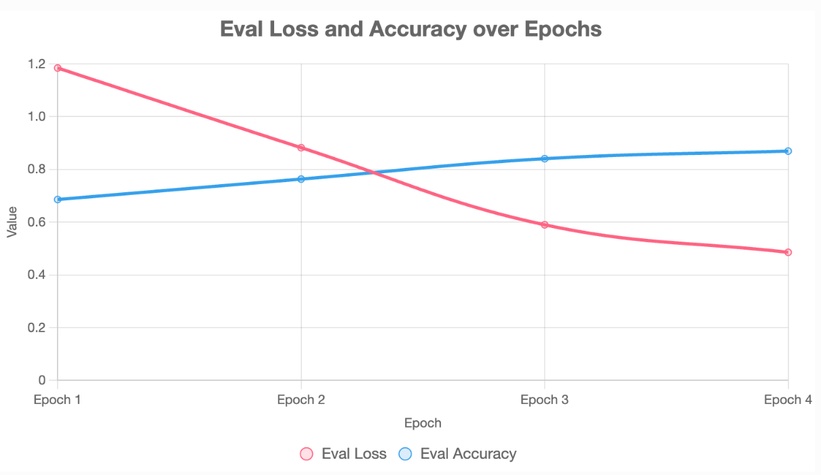
MobileViTv3

Slide 28
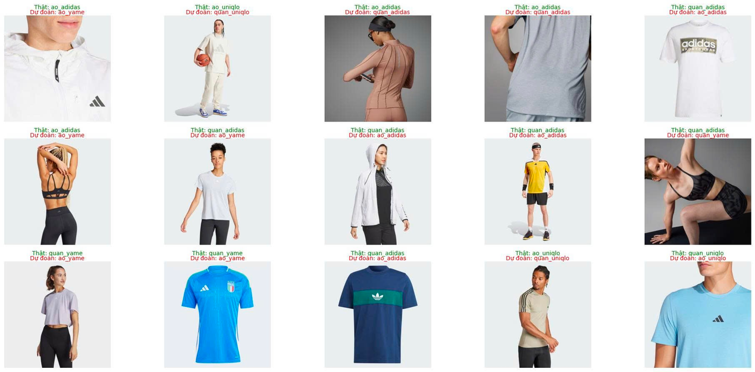
MobileViTv3
TOP 5 LỖI PHỔ BIẾN NHẤT:
1. QUAN_ADIDAS → AO_ADIDAS: 32 LẦN
2. AO_ADIDAS → QUAN_ADIDAS: 23 LẦN
3. AO_ADIDAS → AO_YAME: 11 LẦN
4. QUAN_UNIQLO → AO_UNIQLO: 10 LẦN
5. QUAN_ADIDAS → AO_YAME: 8 LẦN

Slide 29
KHẢO SÁT MODEL - TASK IMG CLASSIFICATION
Model | Top-1 Accuracy (%) | Parameters (Millions) | Notable Features
CoCa | 91 | Varies | Combines contrastive learning with captioning
ViT-G/14 | 90.94 | High | Treats images as patch sequences
EfficientNetV2-L | 85.7 | 120 | Optimized scaling and training speed
ResNet-152 | 78.3 | 60 | Deep residual learning
MobileNetV3-Large | 75.2 | 5.4 | Optimized for mobile and edge devices
Transformer-in-Transformer | 74.71 | Not specified | Inner-outer transformer with knowledge distillation
https://benchmarks.ai/cifar-100
**TRÊN DATA SET IMAGE-NET VÀ CIFAR-100

Slide 30
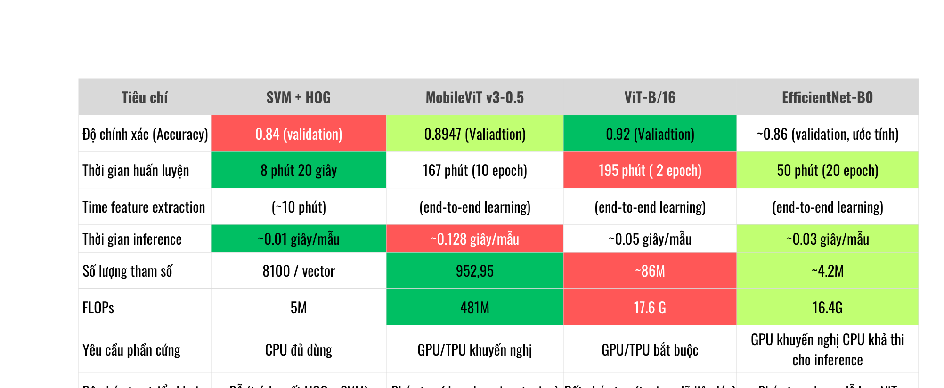

Slide 31
THANK YOU FOR LISTENING
IMAGE CLASSIFICATION OF FASHIONPRODUCTS
FROM ADIDAS, UNIQLO, AND YAME
5.2025

